Slide 1
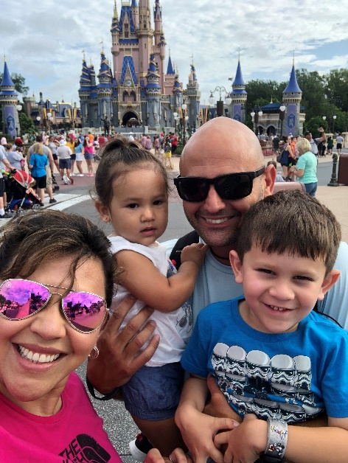
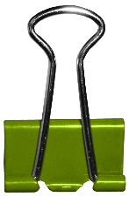
Meet
Michael Buscemi
Favorites:
Favorite Sports Team: Chicago Cubs
Hometown: Plantation, FL
Candy: Reese’s Pieces
Hobbies: Fishing, Working out, and being with my Family
“Practice doesn’t make perfect. Practice makes permanent.”
~David Cutcliffe~
Three Fun Facts About Me
My father was my football coach in high school.
I coached college football for thirteen years at the Division I level.
I like to cook.
Previous School:
St. Augustine High School

