Slide 1
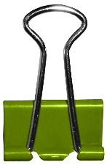
Meet Jessica Allard
Favorites:
Favorite Sports Team: Pittsburgh Steelers
Hometown: Stone Ridge, NY
Candy: Reese’s PB Cups
Hobbies: DIY Home Projects and Working Out
"There is no innovation and creativity without failure. Period.“
- Brene Brown
~
Three Fun Facts About Me
I love The Office and Parks and Rec and have seen every episode more than once.
I danced professionally with a contemporary dance company
I love all things Pittsburgh!
Previous School:
Pedro Menendez High School

